Slide 1
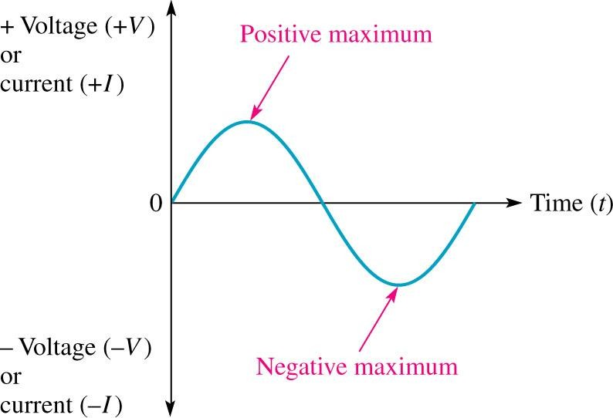
ECE-249
.
Unit-2
Fundamentals of A.C. circuits

Slide 2
Contents:
Alternating Current
Generating Ac Voltages
Determination of Frequency (f) In The Ac Generator Fundamental
Periodic Voltage Or Current Waveform
Average Value
Root Mean Square (RMS) Value
Average And RMS Values Of Sinusoidal Voltage Waveform
Single-phase AC Supply
Purely Resistive Circuit (R Only)
Purely Inductive Circuit (L Only)
Purely Capacitive Circuit (C Only)
2

Slide 3
Cont:
series A.C. circuit
R–L series A.C. circuit
R–C series A.C. circuit
R–L–C series A.C. circuit
Three-phase AC Circuits
Generation of Three-phase Balanced Voltages
Delta(Δ)-Star(Y) conversion and Star-Delta conversion
Delta(Δ)-Star(Y) conversion and Star-Delta conversion impedance conduction
3

Slide 4
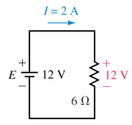
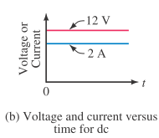
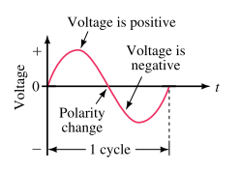
AC Fundamentals
Previously you learned that DC sources have ﬁxed polarities and constant magnitudes and thus produce currents with constant value and unchanging direction
In contrast, the voltages of ac sources alternate in polarity and vary in magnitude and thus produce currents that vary in magnitude and alternate in direction.

Slide 5
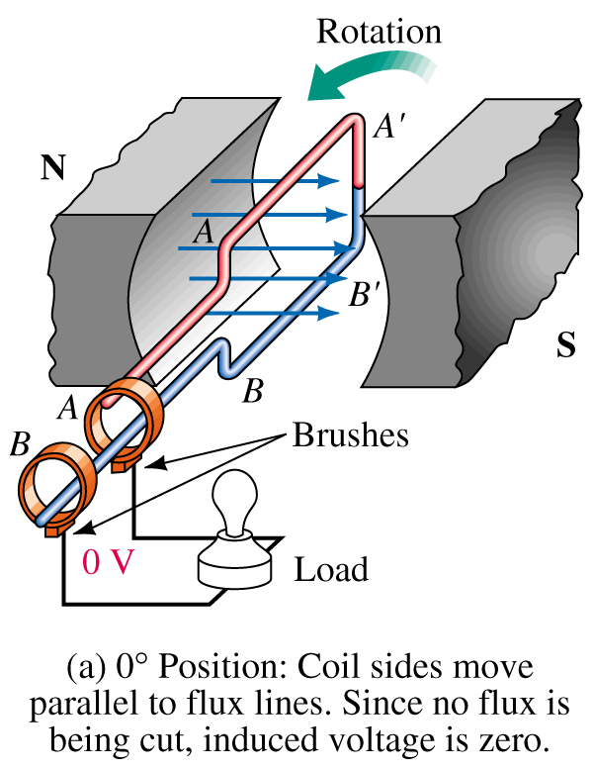
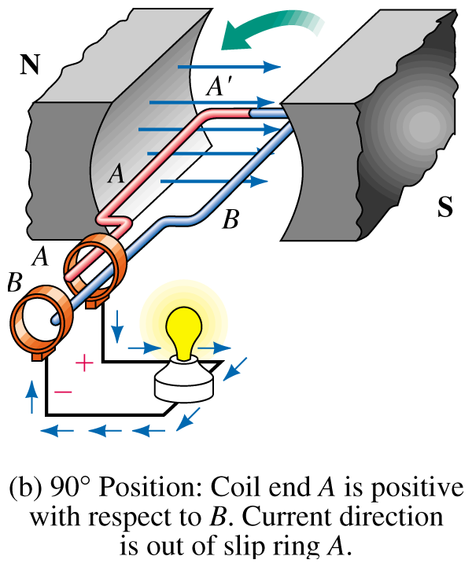
Generating AC Voltages
Generators convert rotational energy to electrical energy.
Generate alternative emf by rotating a coil within a stationary magnetic field.
Another way to rotating magnetic field a within a stationary coil.
5

Slide 6
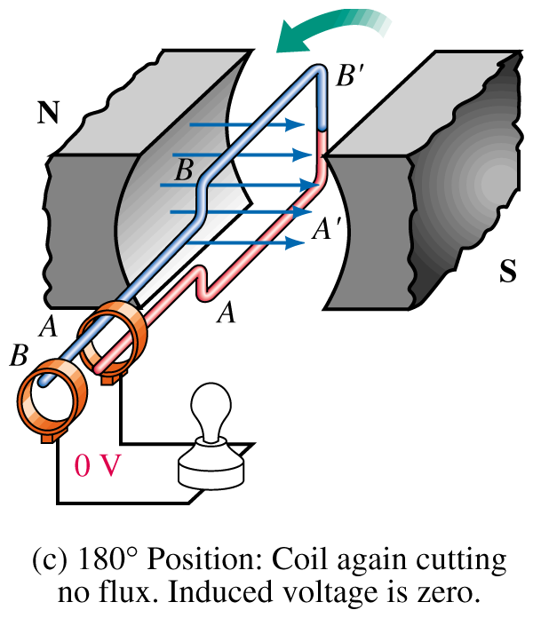
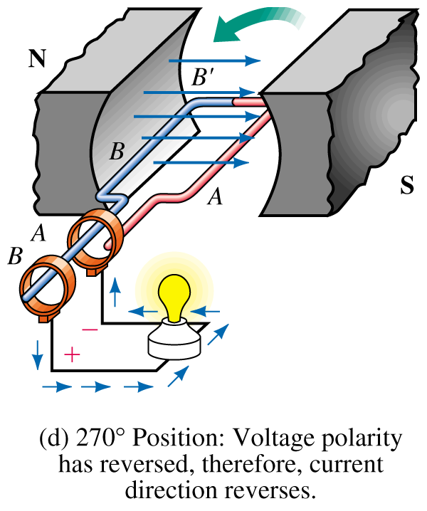
Cont….
The armature has an induced voltage, which is connected through slip rings and brushes to a load.
The armature loops are wound on a magnetic core
6

Slide 7
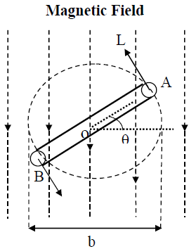
A multi-turn coil is placed inside a magnet with an air gap as shown in above Fig.
The flux lines are from North Pole to South Pole. The coil is rotated at an angular speed,
ω = 2 π n (rad/S)
N is rotating a rectangular coil in a counter clockwise direction with a angular velocity of ω radians per sec in a uniform magnetic field.
The instant of coincidence of the plane of the coil with X-axis. At this
instant max flux, link with the coil
The coil assume the position, as shown in fig , after moving the counter clockwise for t sec.
The angle ө through which the coil has rotated
in sec = ω t.
7

Slide 8


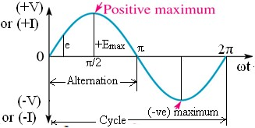
The component of flux along perpendicular to the coil = Φmax Cos ωt.
Flux linkage of the coil at the instant = no. of turns on coil x linkage flux
N Φmax Cos ωt
emf induced in a coil is equal to the rate of change of the flux linkage with minus sign .
emf induced is max at any instant.
Instantaneous emf , e = Emax sin ωt
8
8

Slide 9
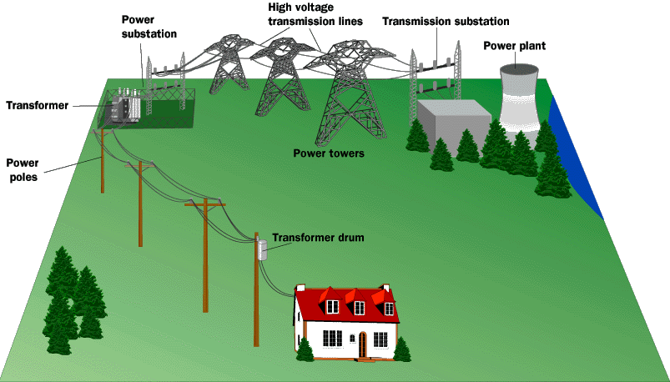
.A way to provide high efficiency, safe low voltage:
step-up to 500,000 V
step-down,
.back to 5,000 V
~5,000 Volts
step-down to 120 V
High Voltage Transmission Lines
Low Voltage to Consumers
05-10-2021
9

Slide 10

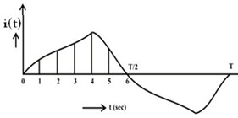

Periodic Voltage or Current Waveform
Average value
The current waveform shown in Fig, is periodic in nature, with time period, T. It is positive for first half cycle, while it is negative for second half cycle.
The average value of the waveform, i(t) is defined as
In this case, only half cycle, or half of the time period, is to be used for computing the average value, as the average value of the waveform over full cycle is zero (0).
If the half time period (T/2) is divided into 6 equal time intervals (TΔ)

Slide 11
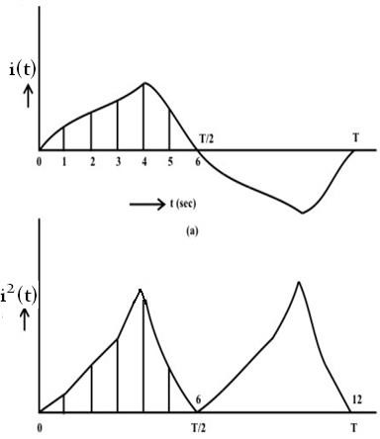


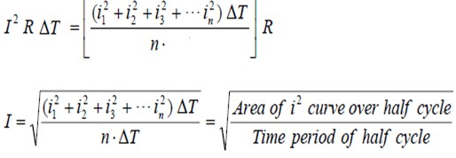

Root Mean Square (RMS) value
For this current in half time period subdivided into 6 time intervals as given above, in the resistance R, the average value of energy dissipated is given by
Heat produce during interval =
jouless

Slide 12


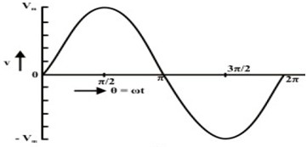




Average Values of Sinusoidal Voltage Waveform
The average value of sine wave over the complete cycle is zero.
The half wave value of sinusoidal current is
For half cycle when ωt varies from 0 to π
Similarly

Slide 13

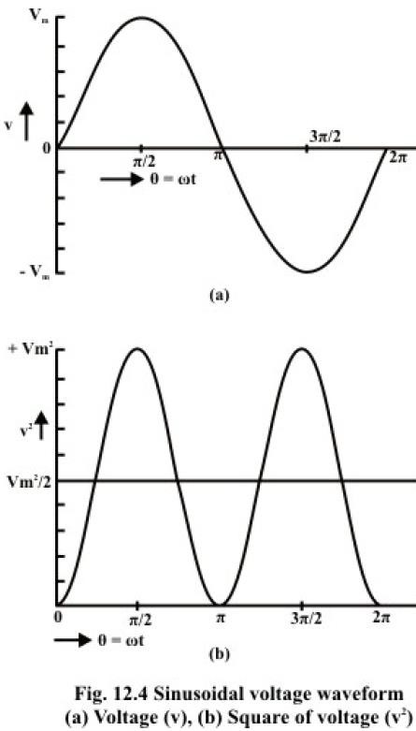
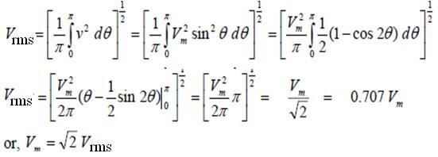

RMS Values of Sinusoidal Voltage Waveform
The waveform of the voltage v(t), and the square of waveform, , are shown in figures 12.4a and 12.4b respectively.
Similarly for current RMA value

Slide 14

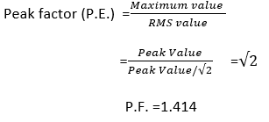
Form factors
The form factor of an alternating quantity is define as the ratio of RMS value to the average value.
Peak value:-
The peck factor of an alternating quantity is define as the ratio of maximum value to the average value
NOTE:-
The rms value is always greater than the average value.
Except for a rectangular waveform, in which case the heating effect
remains constant, so that the average and the rms values are same

Slide 15





Question
Q1) determine the average value and RMS value of sinusoidal current
of peak value 40A.
Solution:- Imax = 40A
Q2) write the instantaneous value for a 50Hz sinusoidal voltage supply
for domestic purposes at 230V.
Solution:- given value Vrms = 230 V. , f = 50 Hz

Slide 16


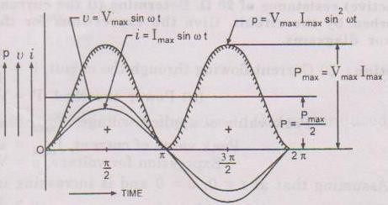
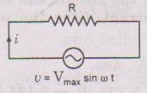

Single-phase AC Supply
Purely resistive circuit (R only)
The instantaneous value of the current though the circuit is given by
Im and Vm are the maximum values of current and voltage respectively

Slide 17
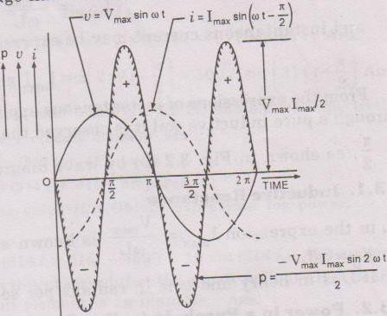
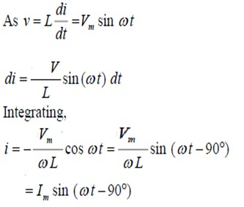
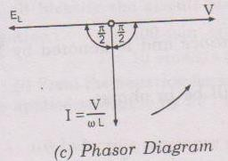
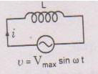
Purely inductive circuit (L only)
For the circuit , the current i, is obtained by the procedure described here
⚫

Slide 18
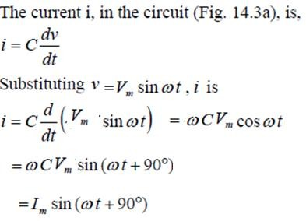
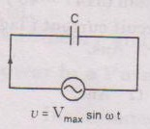
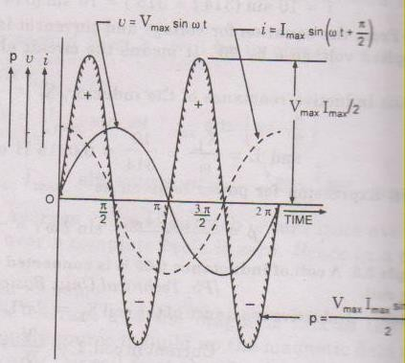
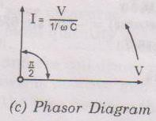
Purely capacitive circuit (C only)

Slide 19

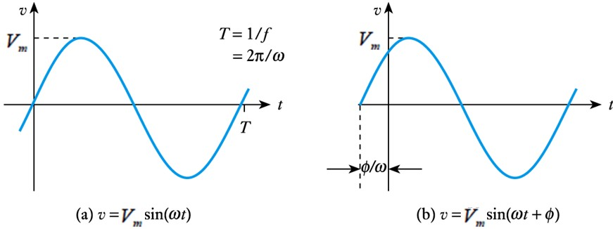
From our earlier discussions we know that
where V_{m} is the peak voltage
ω is the angular frequency
φ is the phase angle
Since ω = 2πf it follows that the period T is given by
_{T =} 1 ₌ 2π
f ω
If φ is in radians, then a time delay t is given by φ /ω as shown
below

Slide 20
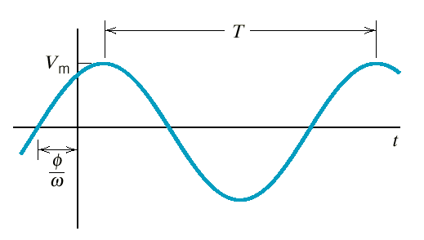
Sinusoidal signals are characterised by their magnitude, their frequency and their phase
Amplitude
Period = 1/f
Phase angle
Angular or radian frequency = 2πf = 2π/T

Slide 21
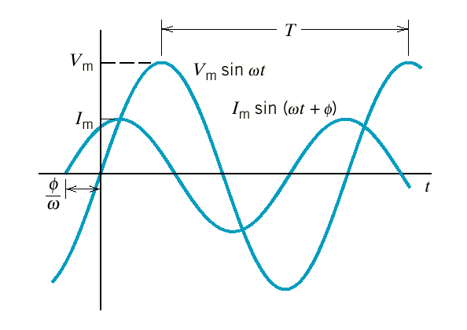

Example
cosθ = sin ⎛θ + ^{π ⎞}
⎜ ₂ ⎟
⎝
⎠
v
sinθ = cos⎛θ − ^{π ⎞}
⎜ ₂ ⎟
⎝ ⎠
i
Circuit element
+
v
_
i
Voltage and current of a circuit element.
The current leads the voltage by φ radians.
OR
The voltage lags the current by φ radians.
05-10-2021
21
21

Slide 22

Mathematical representation of phasor
Phasor can be representation in two way.
Rectangular form
Polar form
Polar form:-
The instantaneous voltagev_{s}
represented in polar form.
= V_{m} sin (ωt + φ )can be
For example v(t) = 20 sin(2πft + 60).
Then it represented in the polar form

Slide 23
For Rectangular form:-
The instantaneous voltagevs
= V_{m} sin (ωt + φ )
can be
represented in Rectangular form.
v(t) = x + jy
Where 'x‘ is x component of the phasor = Vm cos φ
‘y' is y component of the phasor = Vm sin φ
V(t) = Vm cos φ + j Vm sin φ
Example: v(t) = 20 sin(2πft + 60).
v(t) = 20 (cos 60 + j sin 60). = (10 + j17.32)

Slide 24



Conversion from polar to rectangular:
Polar form :
For x component x = r cos φ and y component y
v(t) = x + jy
V(t) = r cos φ + j r sin φ
= r sin φ
Conversion from rectangular to polar :
For rectangular form v(t) = x + jy
For polar form
=

Slide 25
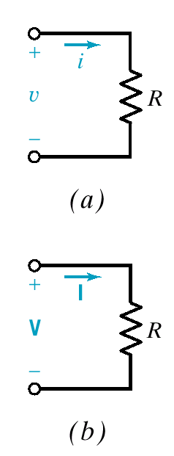
Phasor Relationship for R, L, and C Elements
Time domain
v = Ri
Resistor
Frequency domain
V = RI or I = ^{V}
R
Voltage and current are in phase.

Slide 26
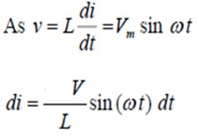
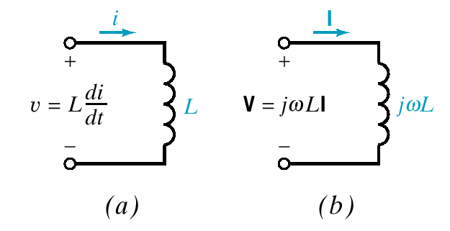
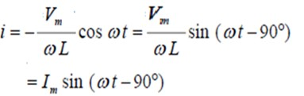
Inductor
Time domain
Frequency domain
_{or I =} V ₌ − jV
jωL ωL
v = L ^{di}
V = jωLI
dt
Voltage leads current by 90°
Current lags voltage by 90°

Slide 27
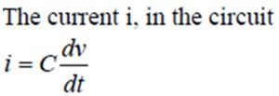
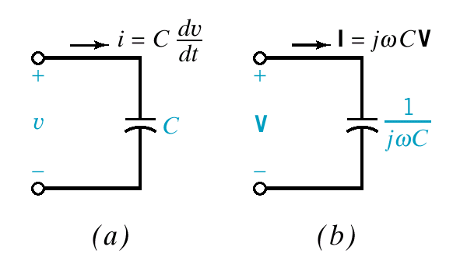
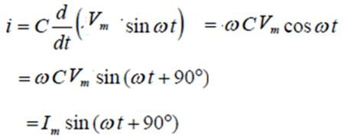

Capacitor
Time domain
Frequency domain
I ₌ − jI jωC ωC
I = jωCV or V =
dv dt
i = C
Voltage lags current by 90°
Current leads voltage by _{90°}

Slide 28
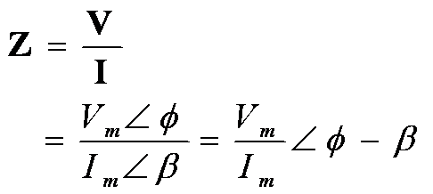
Impedance and Admittance
Impedance is defined as the ratio of the phasor
voltage to the phasor current.
Ohm’s law in phasor notation
phaseθ = φ − β
magnitude Z
or
Z = Z ∠θ
= Ze ^{jθ}
exponential
= R + jX
rectangular
polar
28

Slide 29
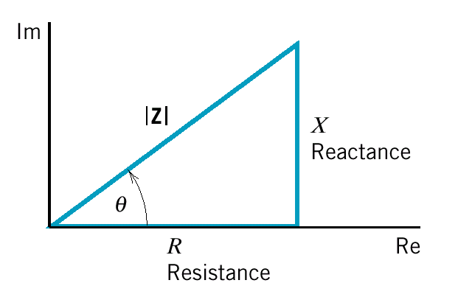
Graphical Representation of Impedance
Z = Z ∠θ
_{R}2
Z = + X ²
θ = tan^{−1 X}
R
R
Resistor
Z = R
Z = jωL
ωL
Inductor
1 ₌ − j jωC ωC
Capacitor
Z =
1/ωC

Slide 30
Admittance is defined as the reciprocal of impedance.
In Polar form
Y =
= Y ∠ − θ
conductance
1
Z Z ∠θ
1
=
In rectangular form
1
R − jX
Y = ¹ =
=
_{R}2
= G + jB
Z R + jX
X ²
1
G
susceptance
Resistor
Y = G =
R
1
Inductor
Y =
1/ωL
jω L
Capacitor
Y = jωC
ωC

Slide 31
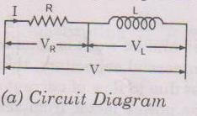
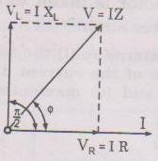






AC circuit with series element
The series R-L Circuit
We consider the ac circuit consisting of resistance of R and inductance of L
connecting in series.
V = VR + VL
VR = I R VL = I XL
V = I R + I XL
where XL = ωL = 2πf L
Vector sum of the VR and VL

Slide 32



Impedance of R-L series circuit
Impedance of R-L series circuit is expressed in the rectangular form as
Z = R + j XL
Expressed in the polar form as
Expression for current:
The current through the R-L circuit is
i(t) = Im Amp.
instantaneous current i(t) = Im sin (ωt - 𝜙)

Slide 33
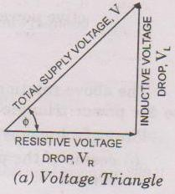




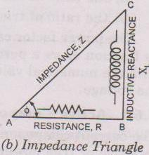


Power in Resistance - inductance circuit
Instantaneous power,
Since average value of pulsating component
over the complete cycle is zero.
The average power of the circuit
V & I are the RMS value of voltage & current and φ is the phase angle between applied voltage & current.
33

Slide 34
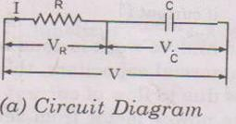
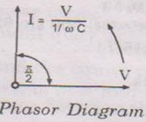
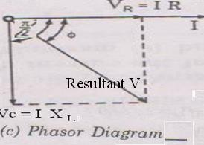
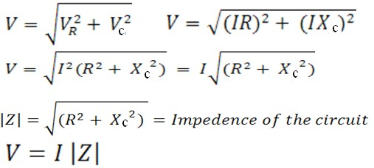
The series R-C Circuit
We consider the ac circuit consisting of resistance of R and inductance of L connecting in series
Voltage drop across R , VR = I R
⚫
(VR is in phase with I)
Voltage drop across C , Vc = I Xc
⚫
(VC lags I by 90)
Applying KVL for RC series circuit
V = VR + Vc
VR = I R and VC V = I R + I XC
Vector sum of VR
= I XC
where XC = 1/ωL = 1/2πf C
and VL
34

Slide 35



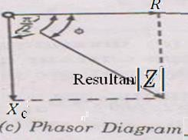

Impedance of R-C series circuit
Impedance of R-C series circuit is expressed in the rectangular form as
Z = R - j XC
Expressed in the polar form as
Expression for current:
The current through the R-L circuit is
i(t) = Im Amp.
instantaneous current i(t) = Im sin (ωt + 𝜙)
3535

Slide 36
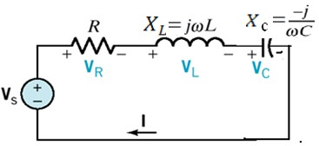





Series R-L-C Circuit
A Phasor Diagram is a graphical representation of phasors and
their relationship on the complex plane.
The voltage phasors are
V_{R} = RI = RI∠0°
V_{L} = jωLI = ωLI∠90°
I
ωC ωC
V = ^{− j} I =
∠ − 90°
V_{s} = V_{R} + V_{L} + V_{C}
C
Applied voltage V, being equal to the phasor vector sum of VR, VL & VC
is given in magnitude
36

Slide 37
Three-phase System

Slide 38



Single phase generator
Three phase generator
38

Slide 39
Three-phase AC Circuits
Generation of Three-phase Balanced Voltages
Three windings, with equal no. of turns in each one, are used, so as to obtain equal voltage in magnitude in all three phases.
Also to obtain a balanced three-phase voltage, the windings
are to be placed at an electrical angle of
other.
Contraction:-
120 with each
consider three identical coil “a1a2”, “b1 b2”, and “c1c2” are mounted in same axis but displaced from each other by 120 rotating in counter clockwise direction in bipolar magnetic field as shown in fig.
40

Slide 40

When a coil “a1 a2” is the position AB the induced emf in this coil is zero.
At that time ‘b1 b2’ is 120 behind the coil ‘a1 a2’ so the emf is induced in this coil as approaching its maximum negative (-ve) value .
At the same time ‘c1 c2’ is 240 behind the coil ‘a1 a2’ so the emf is induced in this coil as approaching its maximum positive (+ve) value and is decreasing
05
-10-2021
41

Slide 41




Some important point
The induced emf in each of the coil are of same magnitude.
The induced emf in each of the coil are of same frequency and Waveform (sinusoidal wave).
The instantaneous value of the emf induced in the coil “a1 a2” , “b1 b2” and “ c1 c2”is given as below.
Note:- if t = 0 corresponding to the instant then voltage & emf of the coil “a1 a2” pass through zero & increasing in positive
₀₅₋₁d₀i₋₂r₀e₂c₁tion.
42

Slide 42




Balance Three Phase Star Connection
The connection diagram of a star (Y)-connected three-phase system is shown in Fig.
Three phase voltages (EP) are:
Three line voltages (EL) are:
ERY
ERB
EYB

Slide 43


Phase Representation of Star Connection

Slide 44



Relation between Phase and Line Voltages for Star Connection
Three line voltages are obtained by the following procedure. The line voltage, ERY is
The magnitude of the line voltage, is ERY is times the magnitude of the phase voltage ERN.
ERY lead the ERN by 30 degree

Slide 45


Cont…
Similarly other line voltages EYB as shown in brief
The magnitude of the line voltage, is EYB is magnitude of the phase voltage EYN.
ERY lead the ERN by 90 degree
times the
Similarly other line voltages EYB as shown in brief
So, the three line voltages are balanced, with their magnitudes being equal, and the phase angle being displaced from each other in sequence by 30.

Slide 46



Relation between the Phase and Line
Current for Star Connection
In the star connected system each line connector is connected to separate phase, so current flowing through the lines and phase
Lines Current IL (IRY, IRB, IYB) = Phase Current IP (IBN, IYN, IRN)
If the phase current has a phase difference of φ with the phase voltage, then
Power output per phase = EP IP cosφ
Total power output phase = 3 EP IP cosφ

Slide 47


Currents for Circuits with Balanced Load (Delta-connected)
⚫

Slide 48




Delta(Δ)-Star(Y) conversion and Star-Delta conversion
The formulas for delta-star conversion, using resistance
The formulas for star-delta conversion, using resistance, are

Slide 49





For impedance conduction
The formulas for delta-star conversion, using impedances.
The formulas for delta-star conversion, using impedance, are

Slide 50
Thank You
.

